Slide 1
Friends of Carnegie Library

Slide 2
Secure
Library
Parliamentary Constituency
Dulwich and West Norwood
Vauxhall
Streatham
Brixton
Clapham
Streatham

Slide 3
Funding would stop on 31st March
Carnegie Library
Minet Library
Tate South Lambeth Library
Upper Norwood Library
Waterloo Library

Slide 4
Future in doubt
Durning Library
West Norwood Library

Slide 5
Lambeth’s current signal
Brixton
Clapham
Streatham
Durning
West Norwood
Carnegie
Minet
Tate South Lambeth
Upper Norwood
Waterloo

Slide 6
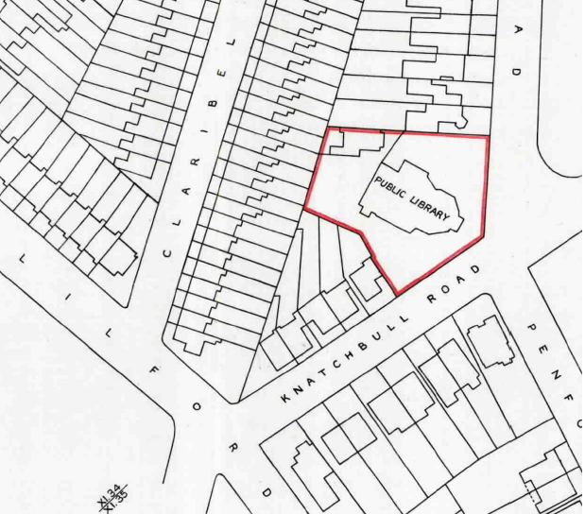

Slide 7
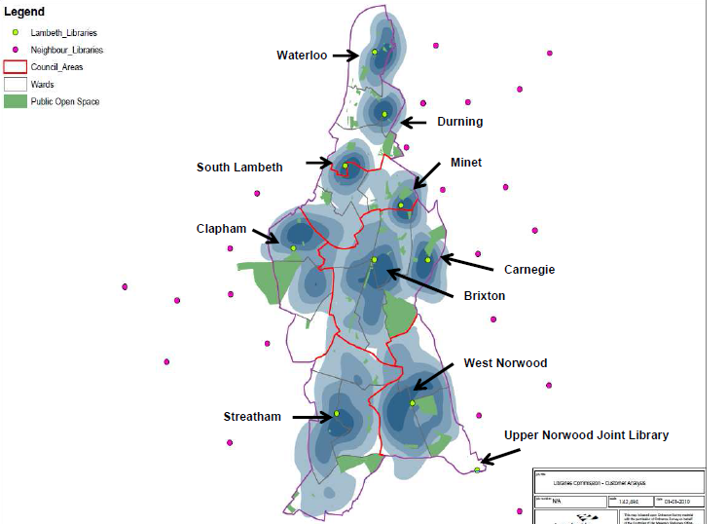

Slide 8
A Local Library
Third busiest children’s library in Lambeth
One in twelve of all Carnegie Library users has a mobility issue
Adult literacy and chess clubs serve the whole of Lambeth but the volunteers are almost all local to Herne Hill.

Slide 9
Libraries’ Management’s Plan
Cut demanded by Lambeth
£800,000
Less
Savings 250,000
Needed £550,000
From “endowment”
£250,000
Add
From
Unspent 300,000
Found £550,000

Slide 10
From Culture 2020 Report

Slide 11
Unspent Health and Wellbeing Budget

Slide 12
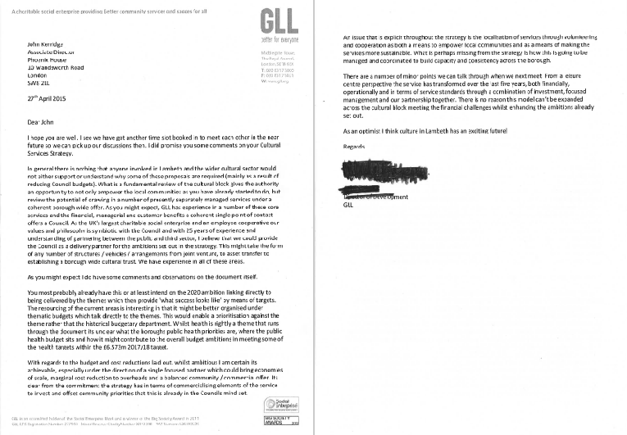

Slide 13
Culture 2020 Report
The report uses the following terms:-
"Healthy Living Centre" is a gym which has a lounge.
"Neighbourhood Library" is a self-service facility in the gym's lounge offering "a small selection of books," Wi-Fi access and computers. In other words not a library.

Slide 14
Carnegie, Minet and Tate South Lambeth 2017/18
As Libraries
As Gyms
Carnegie £200,000
Minet 125,000
Tate South
Lambeth 165,000
Rounded yearly
total £500,000
From Lambeth £670,000
From GLL, being
cross-subsidy from Lambeth Leisure Centres ???????
The gyms’ takings ???????
Total £1 million?

Slide 15
Capital Expenditure
Culture 2020 Report includes a budget of £3 million for converting all the three libraries to gyms, that is,
£1 million each.
Earlier advice from an architect for converting only Carnegie Library into a Community Hub suggested the cost would be
£ 3 million

Slide 16
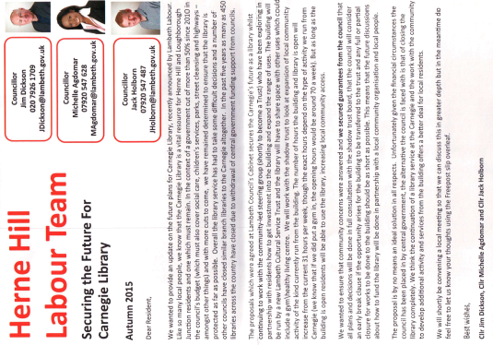

Slide 17
Shadows and Substance
Body | Membership | Known members
Steering Group | Appointed by Lambeth. | Carol Boucher, Fred Taggart and Frances Lamb
Shadow Trust Board | By invitation only. In the event of a disagreement the majority can expel the minority. | Steering Group plus Steve Whaley, Helen Schofield, Cllr Jack Holborn and Phil Isaac
Carnegie Community Trust | Self-appointed. | Shadow Trust Board less Whaley and Holborn

Slide 18
From Strength to Strength April to October 2015 over the same period a year earlier
Increases | Visits | Loans
Lambeth Libraries overall | 5.42% | 2.48%
Carnegie Library | 51.01% | 24.14%

Slide 20
Carnegie Library Users Consultative Group
Friends of Carnegie Library
Ruskin Readers
Carnegie Library Chess Club
Silver Surfers
Book at Breakfast
Carnegie Library Book Group

Slide 21
Our Plans
Build on the success of the library as a hub of the local community and healthy living centre with:
Community-led democratic management of the building
Opening outside library hours by using a panel of vetted and trained volunteers
Minimising administration costs and interventions in the building

